Slide 1

Getting Your Ducks in a Row:
Busting Long Term Planning Myths
Tuesday, May 20, 2025

Slide 2

Long Term Care Overview
Estate Planning Overview
Panel Discussion
Questions & Answers

Slide 3
Long Term Care Options Explained
Caroline Rumowicz
Director, Saint Elizabeth Home Care
Kathy Parker
Director of Care Navigation
Saint Elizabeth Community

Slide 4

Long Term Care Options
Home Care
Adult Day Care
Independent Living
Assisted Living
Memory care
Skilled Nursing Care

Slide 5
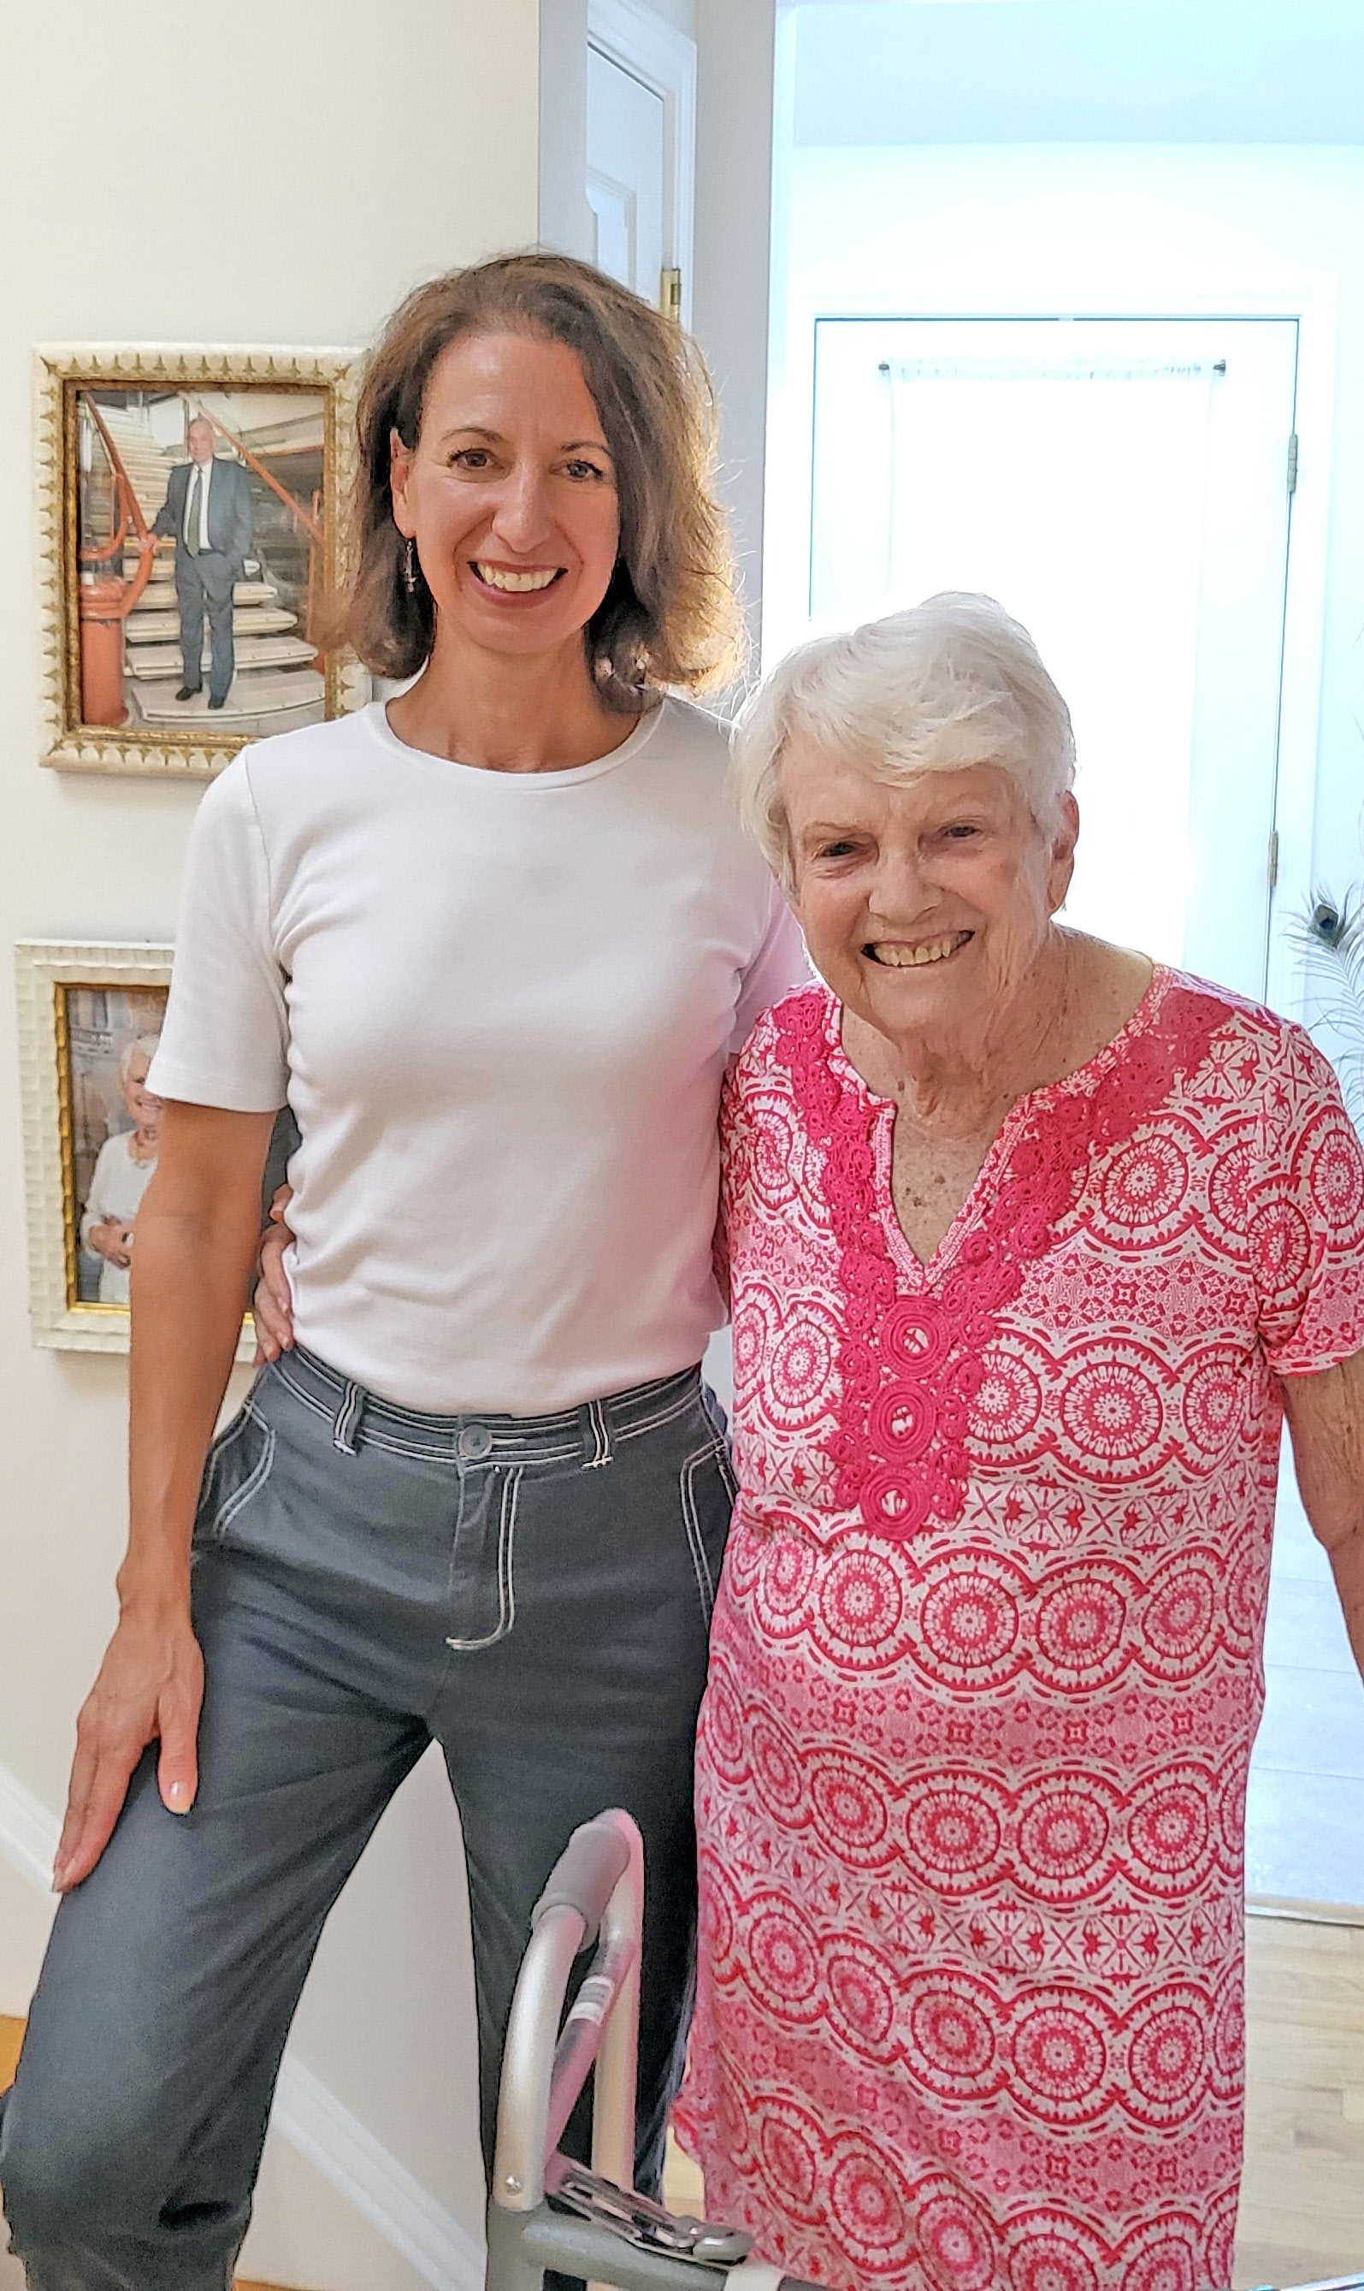
Home Care- Skilled
INCLUDES:
  Nursing
  Physical Therapy
  Occupational Therapy
  Social work services
  Speech Language Pathology
  Home Health Aide
.
covered by health insurance, medicare or medicare advantage and ordered by Doctor

Slide 6

Home Care
Private Duty
INCLUDES:
  Companions
  Home Health Aides
  Help Around the Home
  Assistance with Meals
  Assistance with personal care
Private pay, long-term care insurance, Medicaid/waiver, diocese, & VA Benefits
.

Slide 7
Home Care-
Aging Life Care Specialist
Personalized Care Plan
Coordinates Care
Medication Management
Coordinates Doctors’ Appointments
Attends Doctors’ Appointments
Keeps Family Informed
Review of long-term care insurance policies
PRIVATE PAY

Slide 8
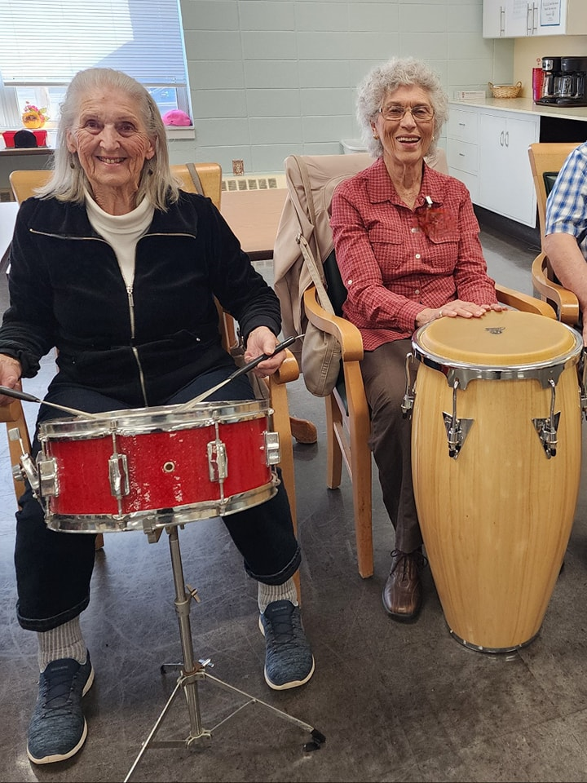
Adult Day Centers
Seniors remain at home
INCLUDES:
    Memory care Needs
    Early memory loss Programs
  Health monitoring
  Medication Management
  Meals and Nutrition
  Personal Care
  Access to therapies
  Socialization
.
  private pay, Medicaid, state co-pay program, respite services, & va Benefits

Slide 9


Independent Living & Senior Housing
  Seniors are independent
  Age restrictions
  Health services not included
  safety features often incorporated
.
  Mostly private pay with a wide range of prices
  Some affordable Medicaid/waiver apartments
  Senior Housing- affordable based on income, long wait lists

Slide 10
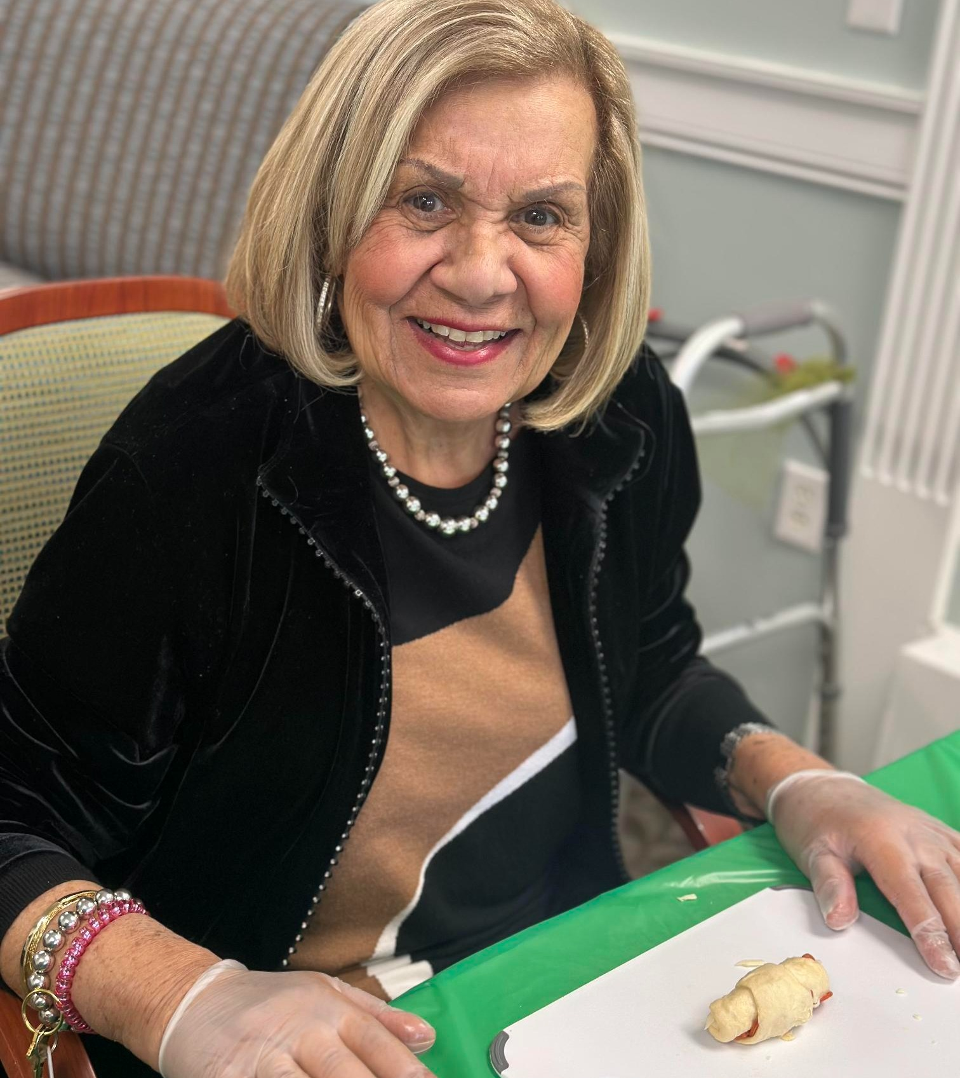
Assisted Living
  Seniors who require more assistance than Home Care but less than a Nursing Home
  Residential community-like environment
  Assistance with personal care, housekeeping & laundry
  Assistance with medication
  Activities & social functions
.
  Mostly private pay with a wide range of prices
  Long-term care insurance
  Some affordable Medicaid/waiver apartments

Slide 11
Assisted Living
Memory Care
Secure environment
Monitoring and Medical Support
Specialized Staff
Structured Activities
Personalized Care Plans
Safe and Comfortable Living Spaces
Social Interaction

Slide 12
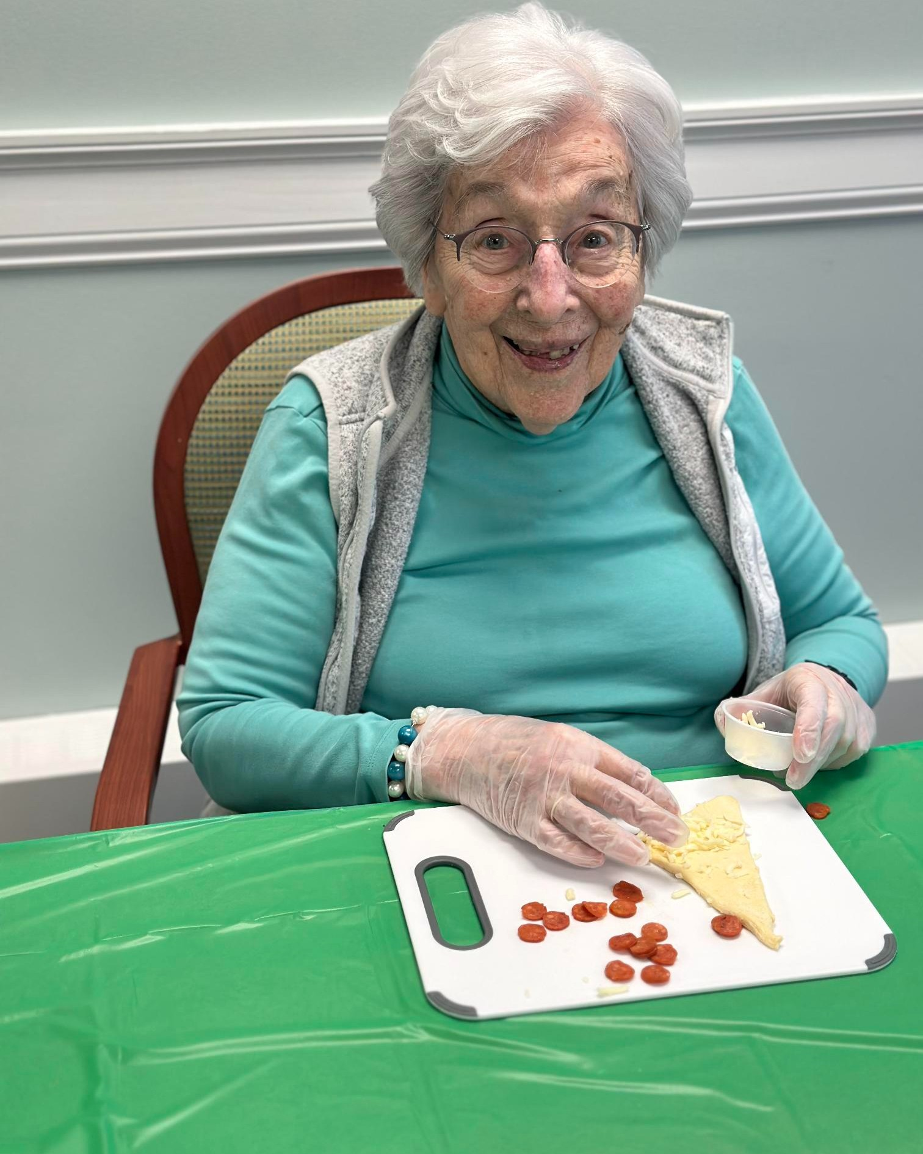
Nursing Home Care
  Seniors who require 24/7 medical care & supervision
  In-house rehab services & specialized care
  Activities & socialization
.
  PRIVATE PAY, LONG-TERM CARE INSURANCE, MEDICAID, MEDICARE & MEDICARE ADVANTAGE

Slide 13
Estate Planning Overview
Kathleen A. Ryan, Esq.
Executive Vice President & Chief Wealth Management Officer
Washington Trust
Amy E. Stratton, Esq.
Partner
Moonan Stratton, LLP

Slide 14

Glossary of Important Terms
Will
A written document, appropriately signed in the presence of the legally required number of witnesses, that provides for the distribution of assets you own at death and the administration of your estate.
Conservator
A person appointed by the probate court to manage the assets of a minor child or incapacitated adult.
Durable Health Care Power of Attorney (or Health Care Proxy)
A document which: (i) grants another individual the power to make health care decisions on your behalf in the event that you are physically or mentally unable to do so, and (ii) may include a living will declaration indicating your desires regarding the use of life-prolonging care and medical treatment.
Durable Financial Power of Attorney
A document which grants another individual the right to exercise specified powers over your financial affairs. The power may be drafted to become effective immediately, or effective only upon subsequent disability or incapacity.

Slide 15
Glossary of Important Terms (cont’d)
Executor/Personal Representative
A person nominated in your will and appointed as fiduciary by the probate court to carry out the provisions of your will. The fiduciary is responsible for the management, preservation, and distribution of the assets in your estate, and for filing federal and state income and estate tax returns, if any.
Guardian
A person appointed by the probate court who is charged with the duty of providing for the physical well-being and/or management of the assets of a minor child or incapacitated adult.
Irrevocable Trust
A trust you create which may not be amended or revoked by you. Under appropriate circumstances, an irrevocable trust can be used to hold an insurance policy and proceeds will not be taxed in your estate. Irrevocable trusts also can be used to protect assets from creditors or for Medicaid planning purposes.

Slide 16
Glossary of Important Terms (cont’d)
Living Will
A written document that provides instruction for your medical care or for continuation or termination of medical treatment. It spells out your wishes for the use or discontinuation of life-sustaining treatments if you become incapacitated and are unable to communicate.
Revocable Living Trust (Inter Vivos Trust)
A trust you create which may be amended or revoked during your lifetime. You may act as trustee and any or all of your assets may be placed in the Revocable Living Trust during your lifetime; these assets will not become public in probate court, providing privacy with respect to your estate.
Trustee
Any person who under the terms of a trust holds legal title to trust assets and invests and manages assets for the benefit and use of another person or group of persons.

Slide 17
Specialty
Irrevocable Trust
Legacy
Will
Revocable Living Trust
Incapacity
Durable Financial Power of Attorney Healthcare Power of Attorney

Slide 20
Getting Your Ducks in a Row:
Busting Long Term Planning Myths
Tuesday, May 20, 2025

Slide 21
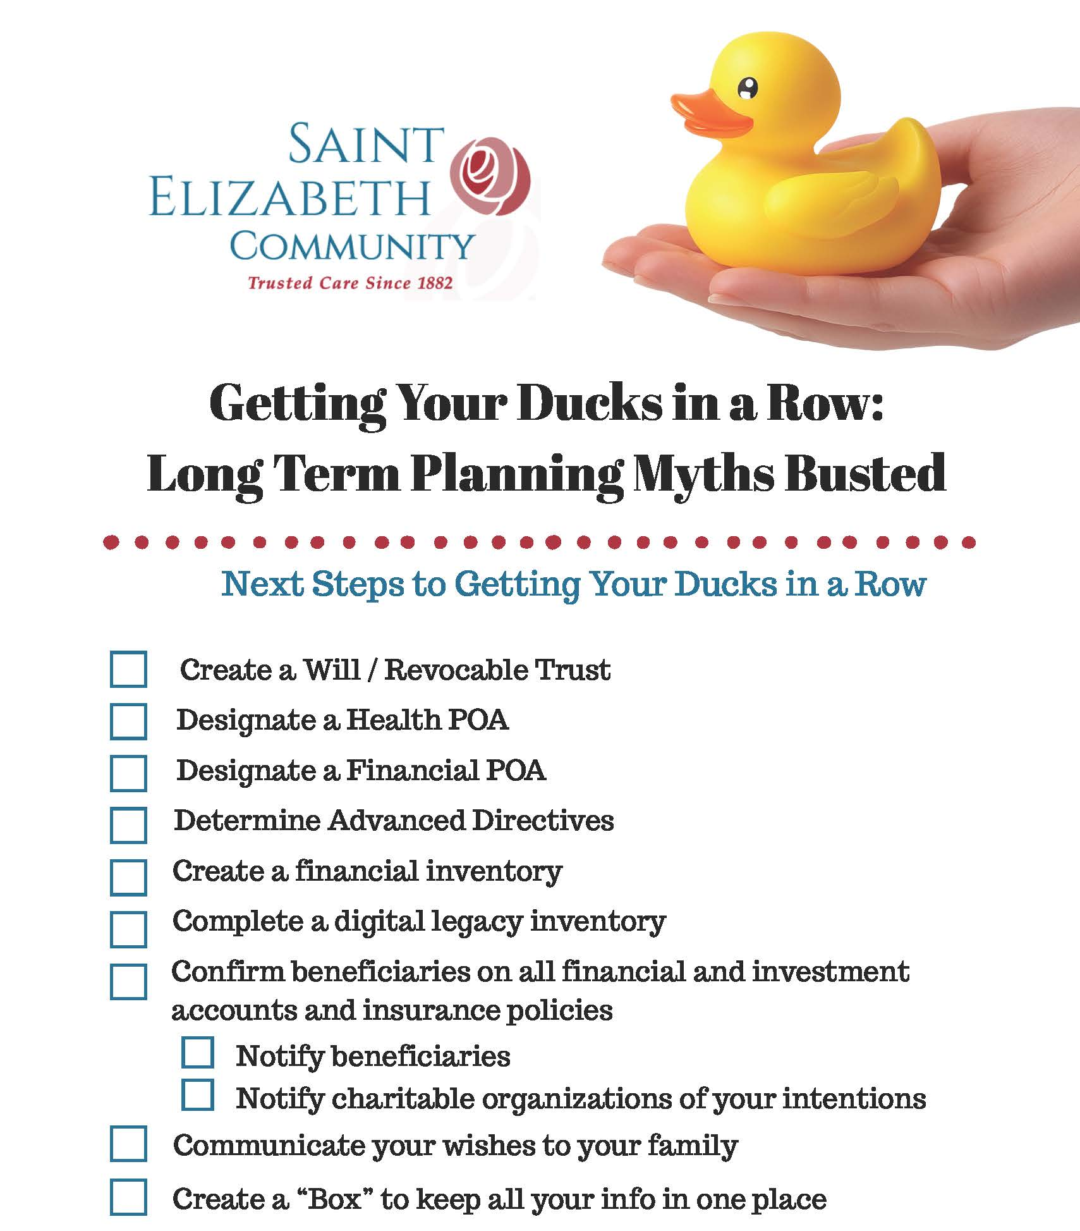

Slide 22
THANK YOU
stelizabethcommunity.org
info@stelizabethcommunity.org

